Slide 1





Airtel RAG Customer Support Chatbot
Retrieval-Augmented Generation for Telecom Customer Service
LLM + SLM Hybrid
Groq LPU
Brand Voice
Built by Kaustubh Nair | AI Training Program — Week 3, Day 5 Assignment

Slide 2
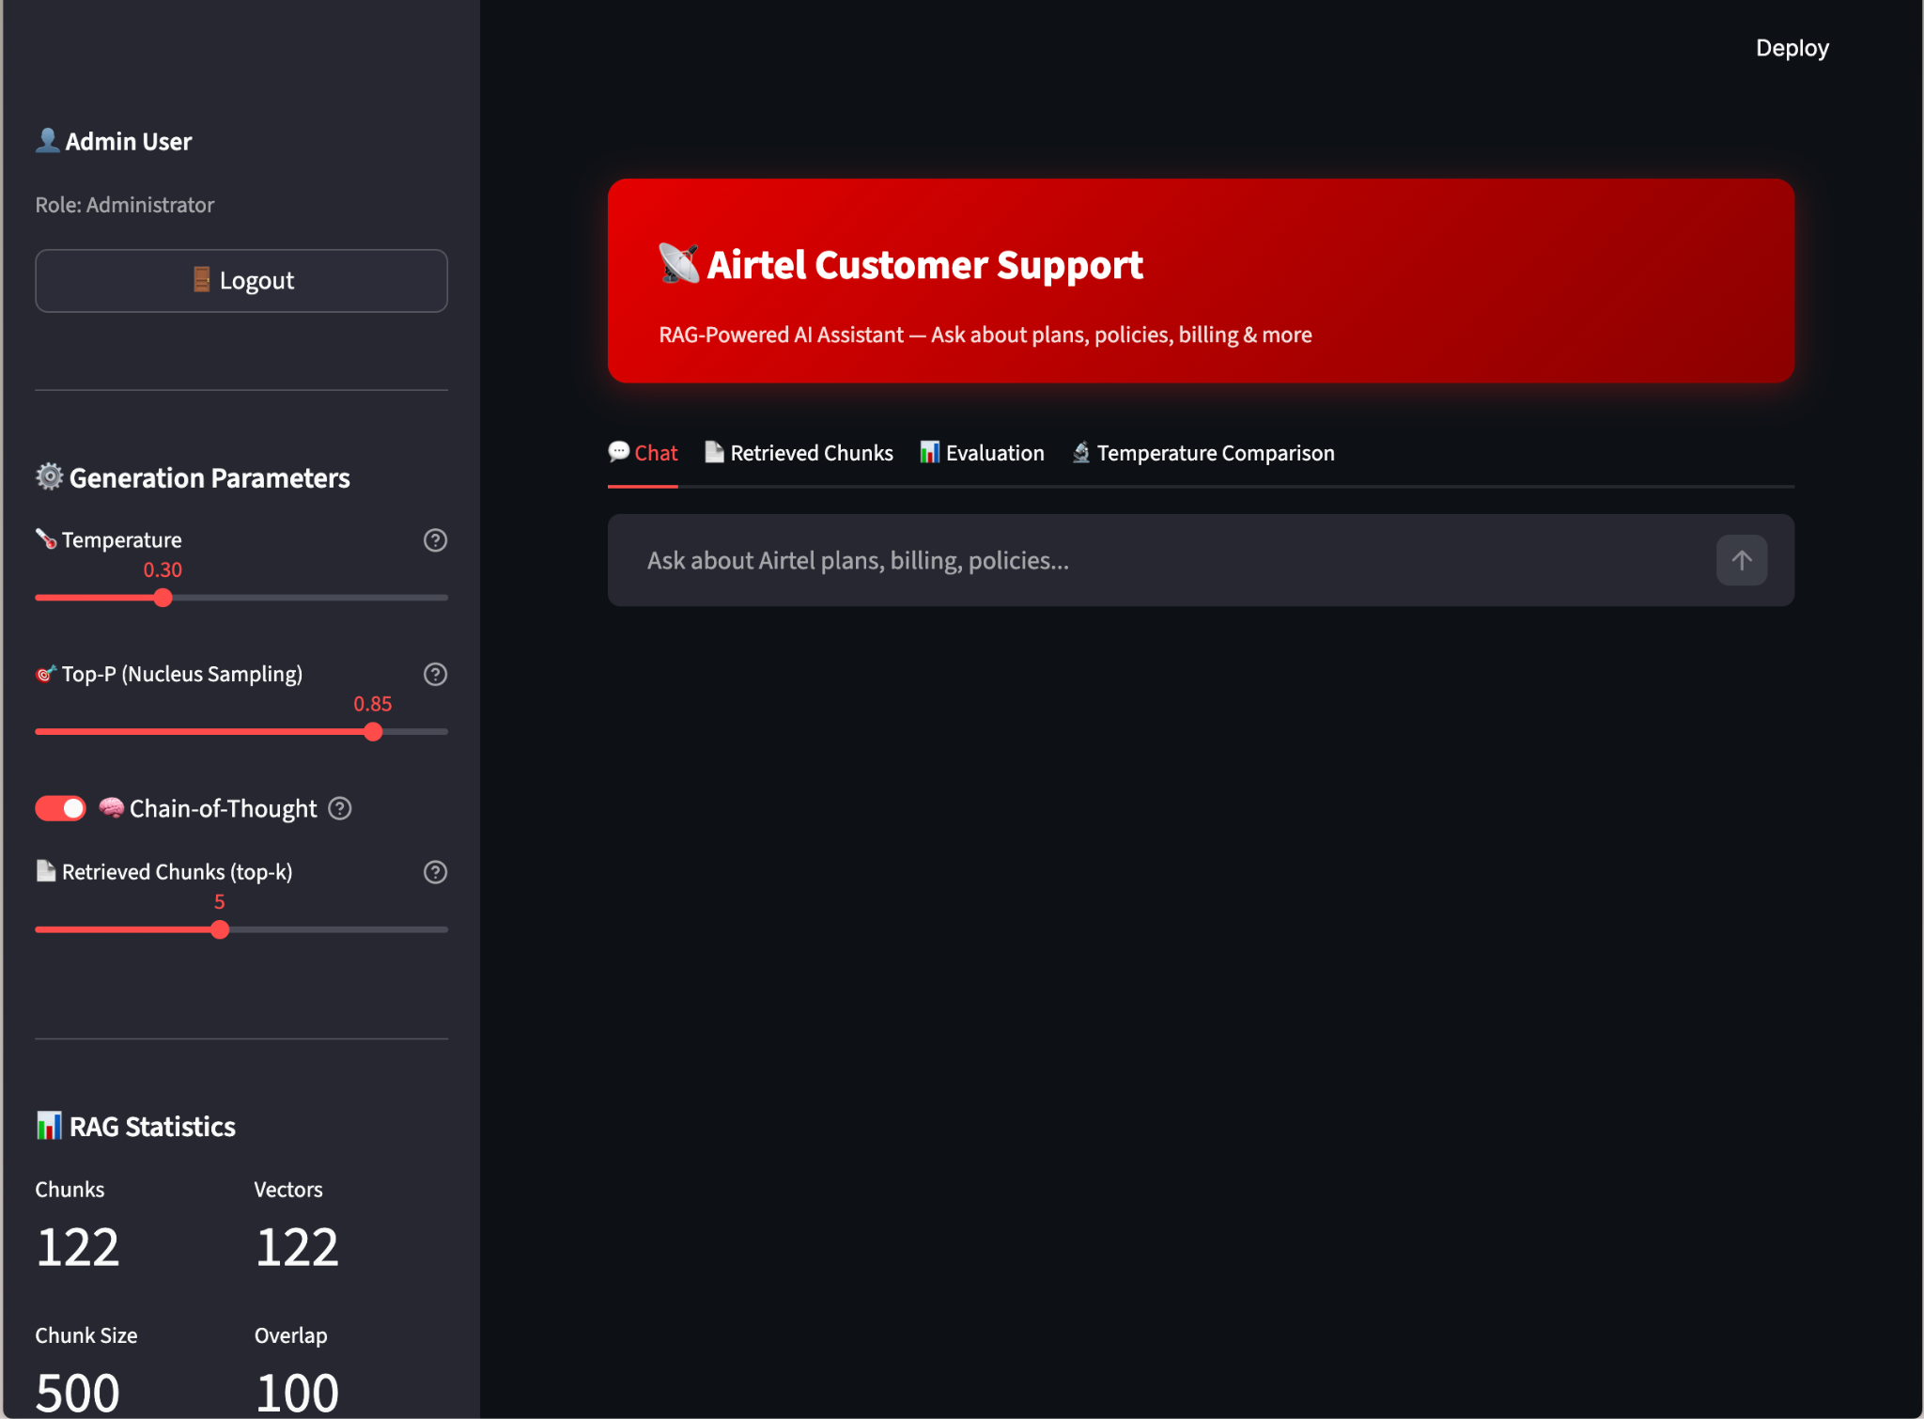



Project Overview
Use Case
Customer Support Assistant for Airtel
Company
Bharti Airtel Limited
India's Leading Telecom Company
Goal
Build a RAG-based chatbot that answers customer queries about Airtel's plans, policies, billing, and services using only verified company documentation
Streamlit-based Chat Interface

Slide 3
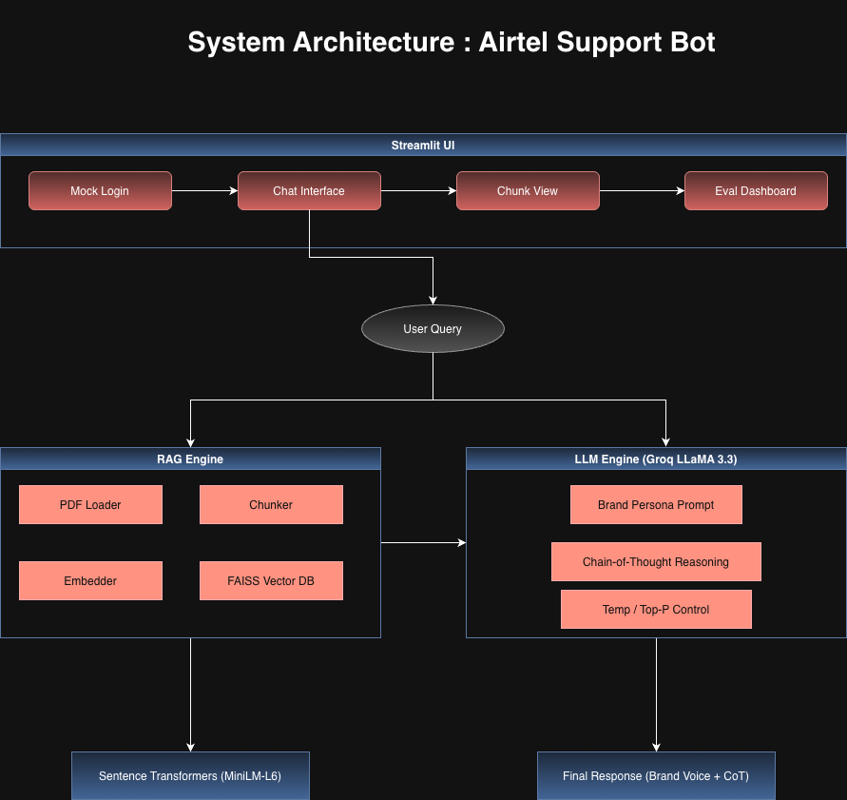



System Architecture
STREAMLIT UI
Mock Login → Chat Interface → Chunk View → Eval Dashboard
RAG ENGINE
PDF Loader → Chunker → Embedder → FAISS DB
LLM ENGINE
Groq LLaMA 3.3 → Brand Persona → CoT Reasoning
EMBEDDINGS
sentence-transformers (MiniLM-L6-v2)
Response Generation: Combines retrieved context with brand voice and CoT reasoning

Slide 4







Technology Stack
LLM
Embeddings
Groq (LLaMA 3.3 70B Versatile)
all-MiniLM-L6-v2
Ultra-fast inference via Groq's LPU, excellent instruction-following
Lightweight (80MB), fast, 384-dim. Ideal for semantic search without GPU
Vector DB
Chunking
FAISS (Facebook AI)
LangChain RecursiveCharacterTextSplitter
Fast similarity search, no server needed, persistent storage
500-char chunks with 100-char overlap for optimal retrieval
UI
Authentication
Streamlit
Custom Mock Login (SHA-256)
Rapid prototyping, built-in chat components
Simple security gate as required
Hybrid approach: Cloud LLM for quality + Local SLM for efficiency

Slide 5
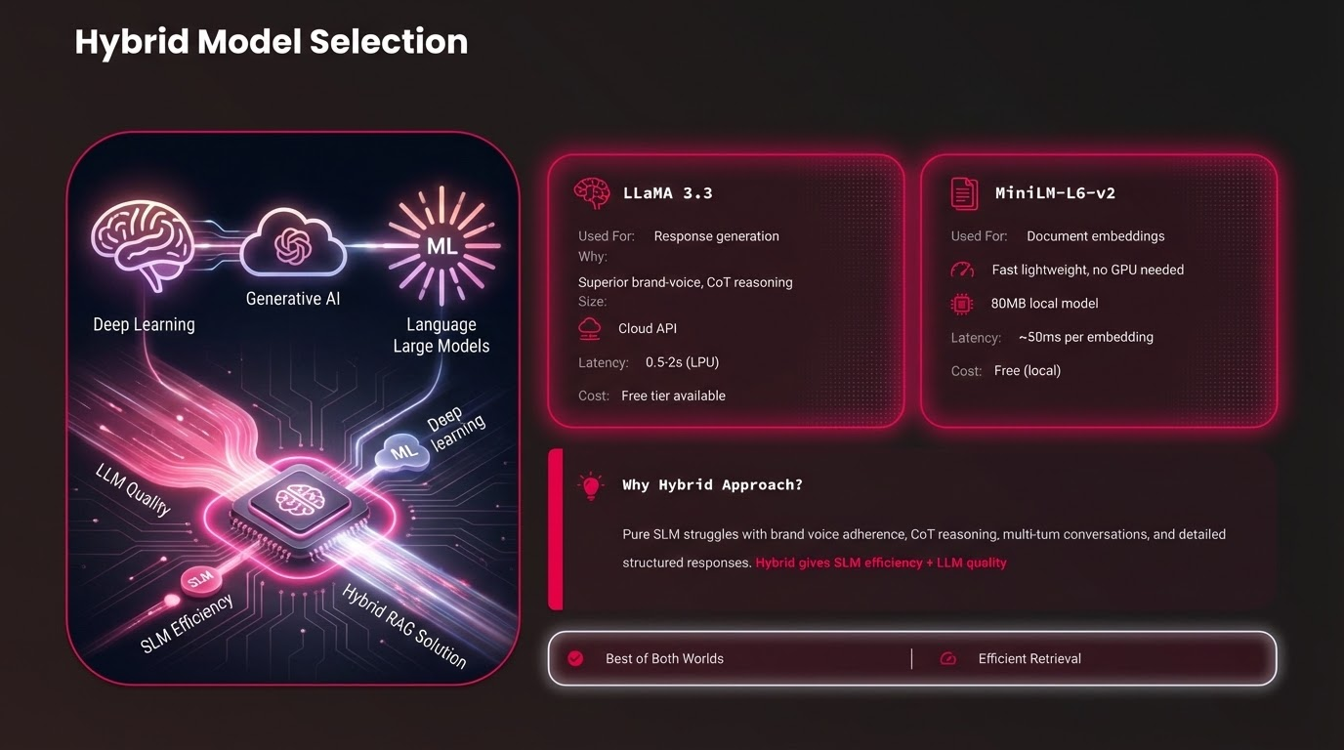

Slide 6







Key Features
RAG Pipeline
Brand Voice
Chain-of-Thought
Parameter Controls
PDF loading → Chunking → Embedding → FAISS → Retrieval → Generation
Strict "Airtel Assist" persona using only provided context
Model explains retrieval logic before answering
Live sliders for Temperature and Top-P generation parameters
Chunks Display
Mock Login
Evaluation Suite
Multi-turn Chat
Dedicated tab showing source chunks with relevance scores
Username/password authentication gate with SHA-256 hashing
10-question benchmark with keyword matching & hallucination detection
Conversation history maintained for context across interactions
End-to-end RAG solution with comprehensive evaluation and real-time parameter tuning

Slide 7

Setup & Installation
1
Clone Repository
2
Virtual Environment
git clone https://github.com/KaustubhNair-bot/AI_Tr_BOT.git
python3 -m venv venv
source venv/bin/activate
cd AI_training_BOT/RAG_real_life_use_case_kaustubh
3
Install Dependencies
4
Set Up API Key
pip install -r requirements.txt
cp .env.example .env
Add your Groq API key in .env file
5
Run the App
6
Login
streamlit run streamlit_app.py
admin/admin123
agent/agent123
demo/demo123
Get your Groq API key at: https://console.groq.com/keys

Slide 8









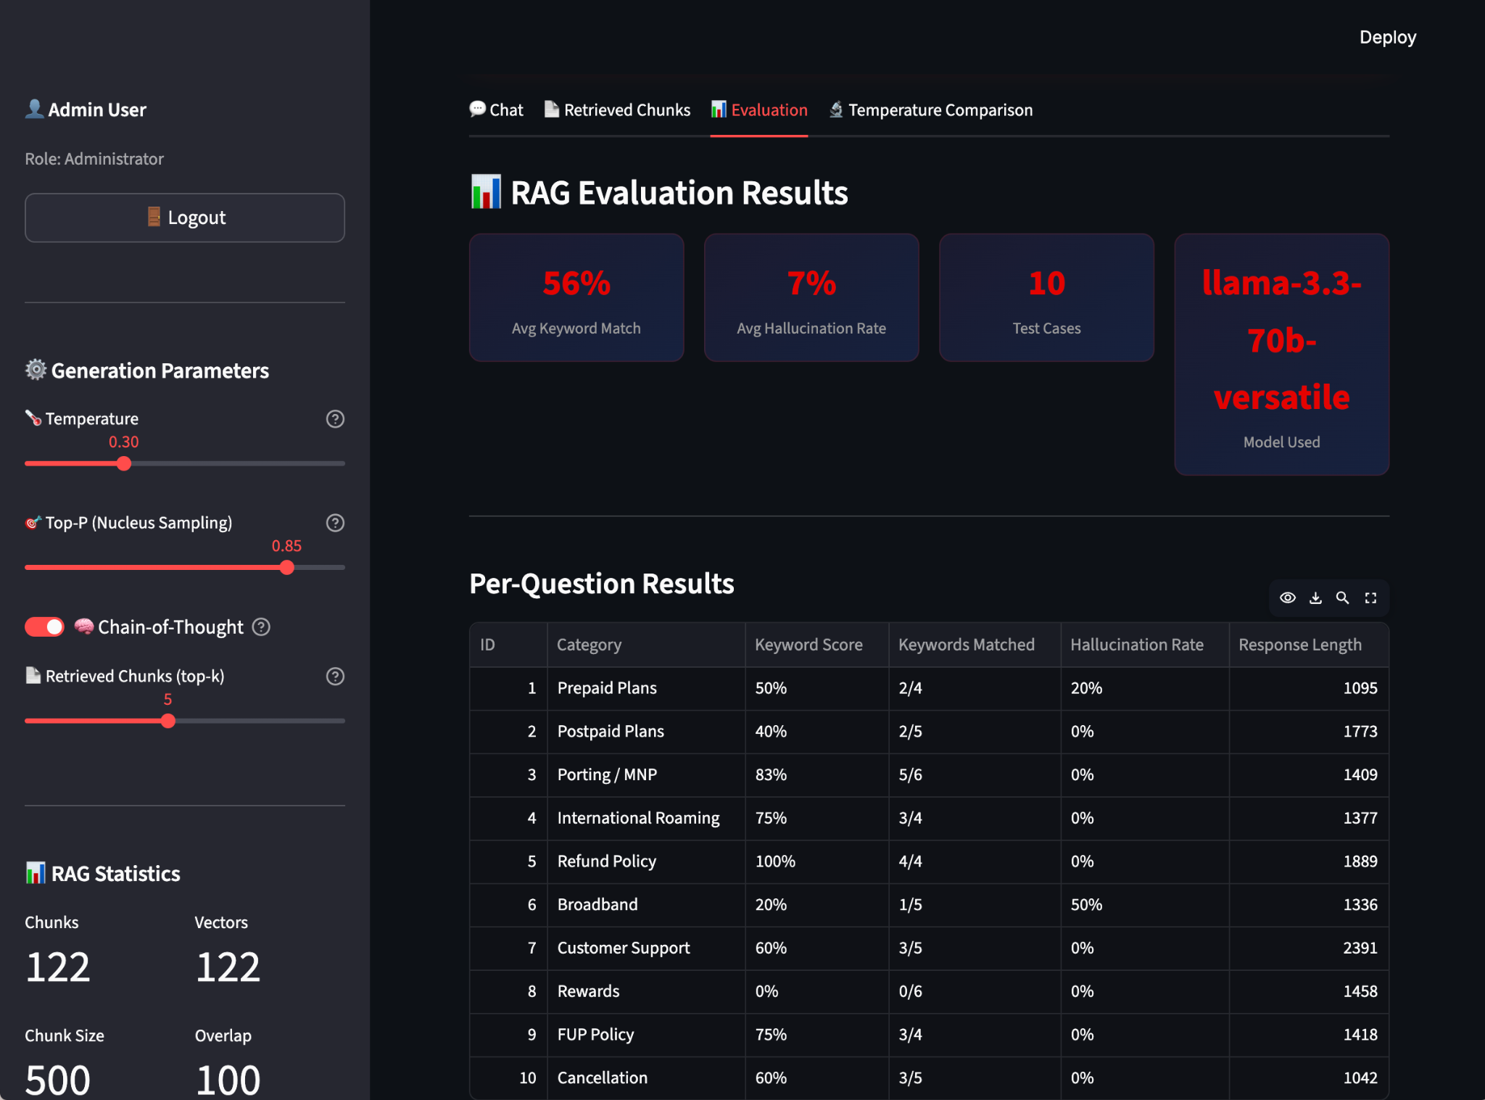

Evaluation & Performance
Evaluation Categories
Performance Metrics
Prepaid Plans
Postpaid Plans
Keyword Match Score
Hallucination Rate
Porting / MNP
Intl. Roaming
Percentage of expected keywords found in response
Percentage of unsupported numeric claims
Refund Policy
Broadband
Customer Support
Rewards Program
Fair Usage Policy
Cancellation
Generation Parameters Comparison
Factual
Balanced
Creative
Temp: 0.0
Temp: 0.3
Temp: 0.8
Top-P: 0.5
Top-P: 0.85
Top-P: 0.95
Lowest Hallucination
Low Risk
Higher Risk
Optimal Settings: Temperature 0.0–0.3 with Top-P 0.5–0.85 provides best balance of factual accuracy and brand-voice adherence

Slide 9








Conclusion & Key Takeaways
Security Features
Optimal Parameters
SHA-256 hashed passwords
Temperature
0.0 - 0.3
Session-based authentication
Top-P
0.5 - 0.85
API key stored in .env
Best balance of factual accuracy and brand-voice adherence
Context constraints
Project Success Factors
Future Potential
Hybrid LLM + SLM approach
Scalable to other telecom companies
End-to-end RAG pipeline
Enhance with more data sources
Comprehensive evaluation suite
Potential for real-time integration
Brand voice persona enforcement
Project Success
Built by Kaustubh Nair
The hybrid RAG approach delivers the perfect balance of efficiency, accuracy, and brand consistency for customer support applications
AI Training Program

